Slide 1
Lesson 4 - Random Circles
Mr Mack 2019

Slide 2
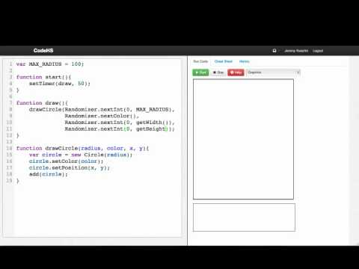

Slide 3
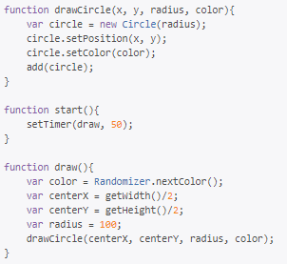
What does this program do?
Draws 1 randomly sized circle at a random place on the canvas.
Draws several randomly sized circles at random places on the canvas by drawing 1 every 50 milliseconds.
Draws 1 randomly colored circle at the center of the canvas.
Draws several randomly colored circles at the center of the canvas by drawing 1 every 50 milliseconds.

Slide 4
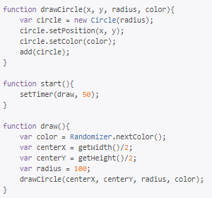
Which statement would stop the timer in the following program?
stopTimer(drawCircle);
stopTimer(draw);
stopTimer(draw, 50);
stopTimer(draw());

Slide 5
Example: Random Circles
This is an example for this lesson. You are encouraged to play around with it, run and change the code, and learn how it works. When you are done, click continue to go to the next problem.

Slide 6
Example: Spinner Example
This is an example for this lesson. You are encouraged to play around with it, run and change the code, and learn how it works. When you are done, click continue to go to the next problem.

Slide 7
Exercise 3.4.1: Growing Circle
You should write a program that draws a circle of size START_RADIUS in the middle of the screen and then animates the circle growing by INCREMENT every 50 milliseconds.
You should use circle.setRadius() and circle.getRadius().
When the circle covers the whole height, you should stop the timer.
Every time the circle grows by CHANGE_COLORS_AT, you should change to color to a random color. (Hint: you’ll need to use the mod operator %)
Getting and Setting the Radius
getRadius() can be used to find the radius of a circle. It returns an integer. For example, if the program has a blue circle named blueCircle with a radius of 15, blueCircle.getRadius() will return 15. This value can be store in a variable.
The radius of a circle can be updated in a similar manner using setRadius. Using the blueCircle example from above, the radius could be set to 30 with blueCircle.setRadius(30).

Slide 8
Exercise 3.4.2: Paint splatter
Write a program that splatters paint on the screen every DELAY milliseconds.
To splatter paint, pick a random color and draw CIRCLES_PER_SPLATTER circles of that color at random places on the screen. The radius of each circle should be a random value between MIN_RADIUS and MAX_RADIUS.
Remember to use helper functions.

